Slide 1
Developer Exchange Group
深入淺出設計模式#5:
轉接器模式與表象模式
Prepare by Sean Hsieh

Slide 2
Adapter pattern

Slide 3
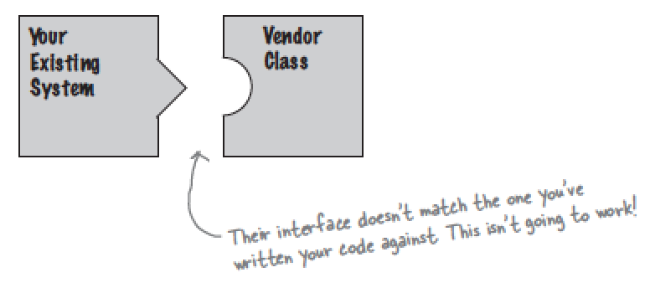
Scene
New interface doesn’t work
New vendor designed their interfaces differently than the last vendor.
Data source: Head first design pattern

Slide 4
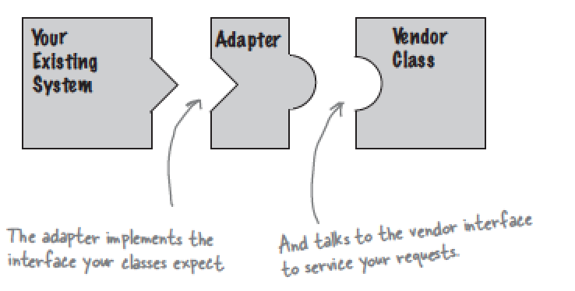
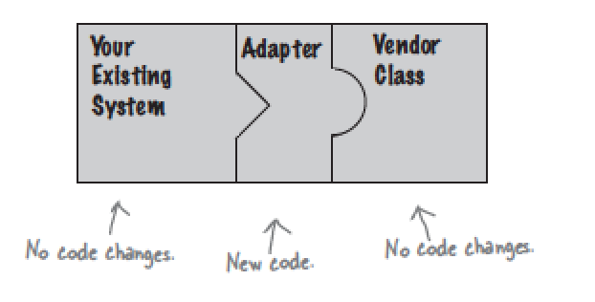
How to use old design?
An adapter designed
Designed an interfaces to adapter the old interface.
Data source: Head first design pattern

Slide 5
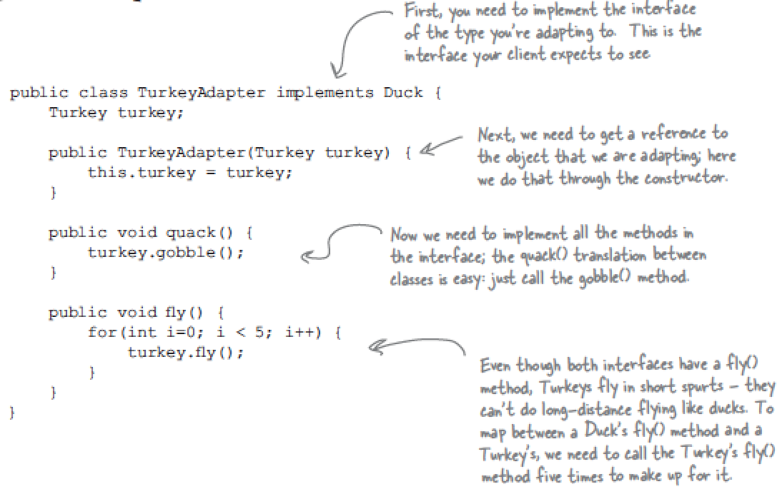
Example of adapter class
Turkey gobble()
Fly()
Duck quack()
Fly()
Data source: Head first design pattern

Slide 6
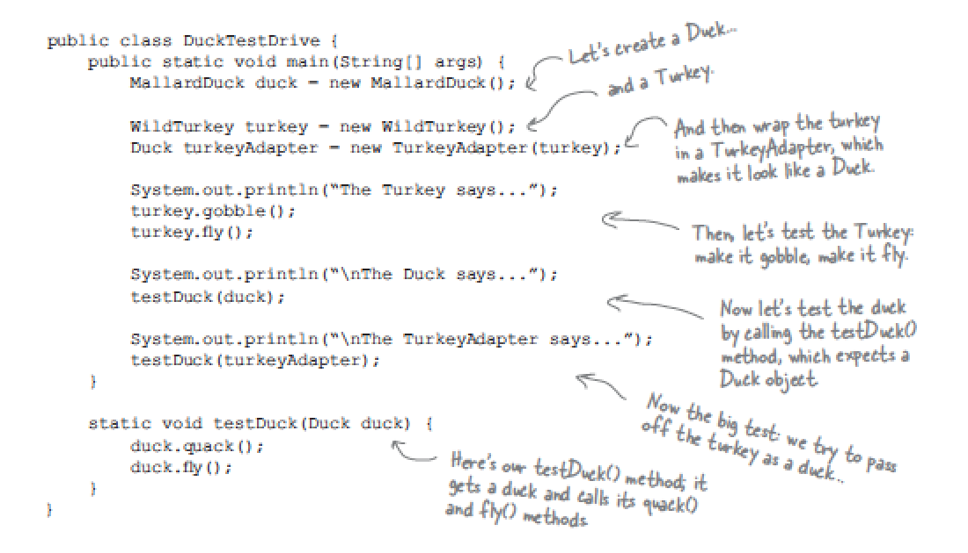
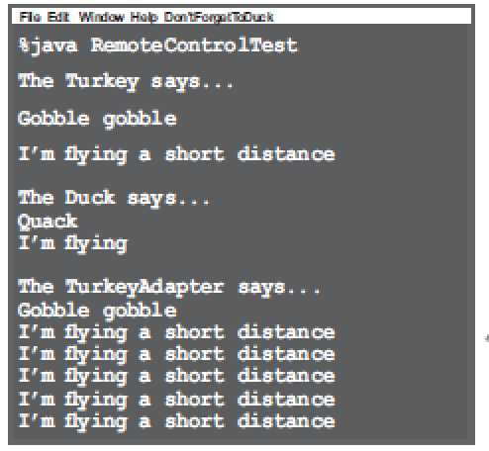
Example of using adapter class
Data source: Head first design pattern

Slide 7
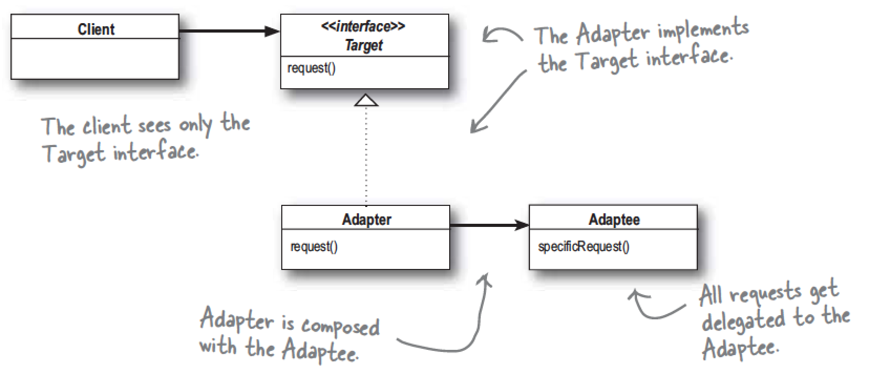
Definition of adapter pattern
Adapter pattern
When you need to use an existing class and interface is not the one you need
Usage:
converts the interface of a class into another interface the clients except
Data source: Head first design pattern

Slide 8
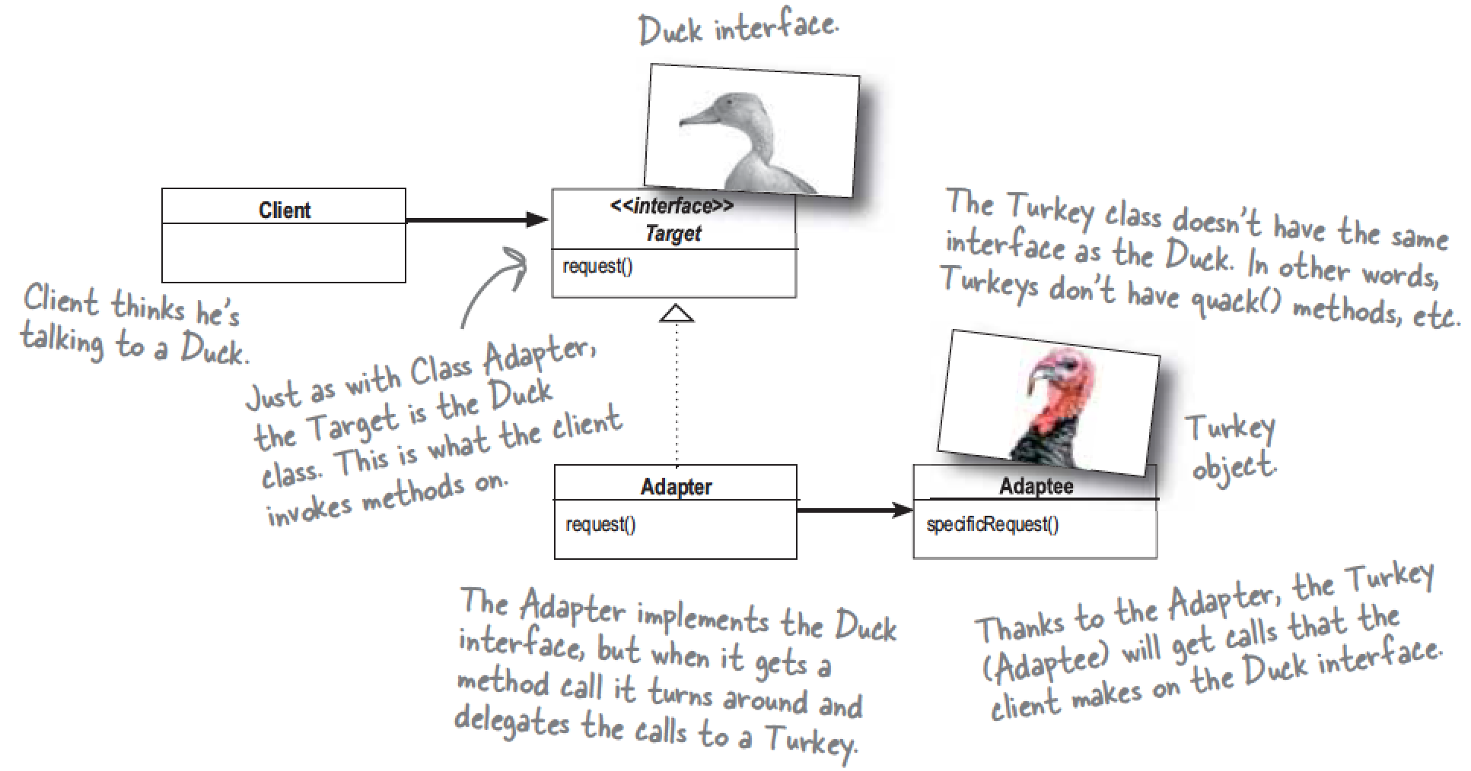
Kinds of adapter pattern
1. Object Adapter
Data source: Head first design pattern

Slide 9
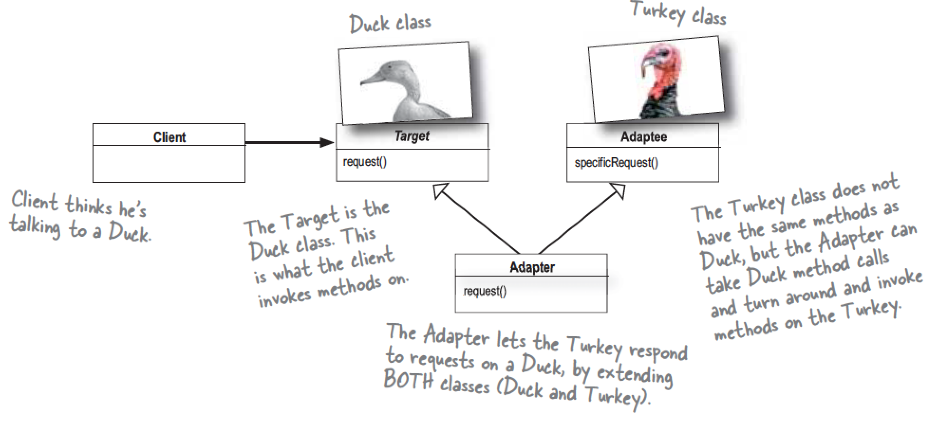
Kinds of adapter pattern (cont.)
2. Class Adapter
Class adapter use multiple inheritance, so you can’t do it in JAVA
Data source: Head first design pattern

Slide 10
Note
1. We could use adapter with any subclass of the adaptee.
2. Use adapter to decouple the client from the implemented interface.
3. You can rework all your client-side calls to the interface, which would result in a lot of investigative work and code changes.

Slide 11
Facade pattern An adapter hold two or more adaptee

Slide 12
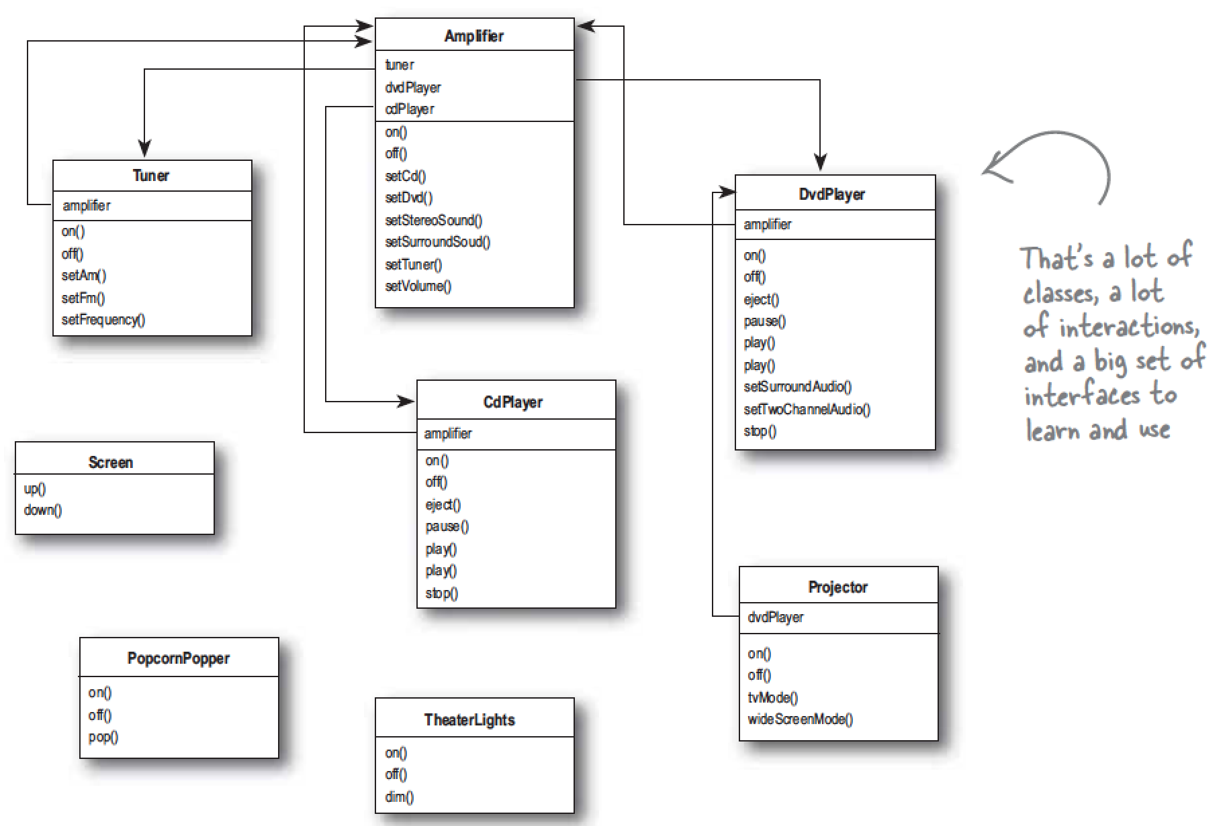
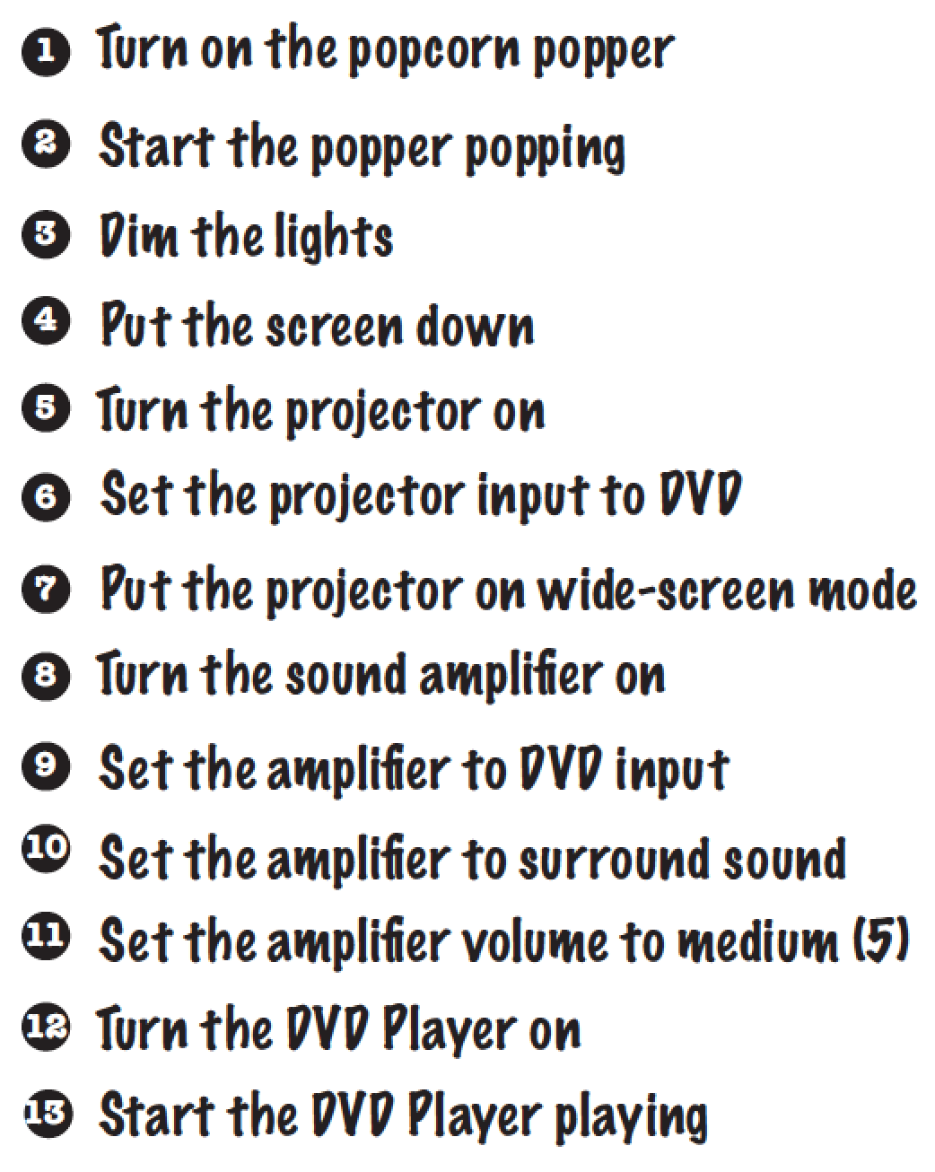
scene
Data source: Head first design pattern
Home theater
We have to do many thing before watching movie

Slide 13
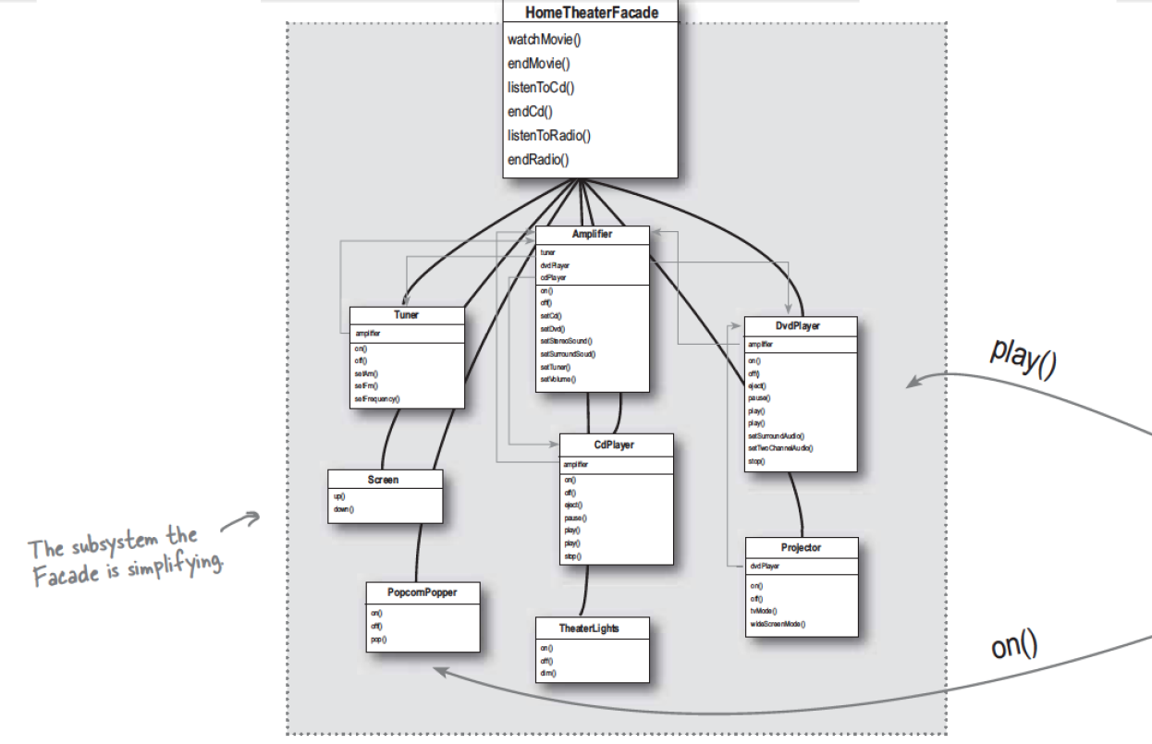
How to simplify these procedure?
Facade pattern
When you need to simplify and unify a large interface or complex set of interfaces
Usage:
Create a facade class with a simplified method.
Data source: Head first design pattern

Slide 14
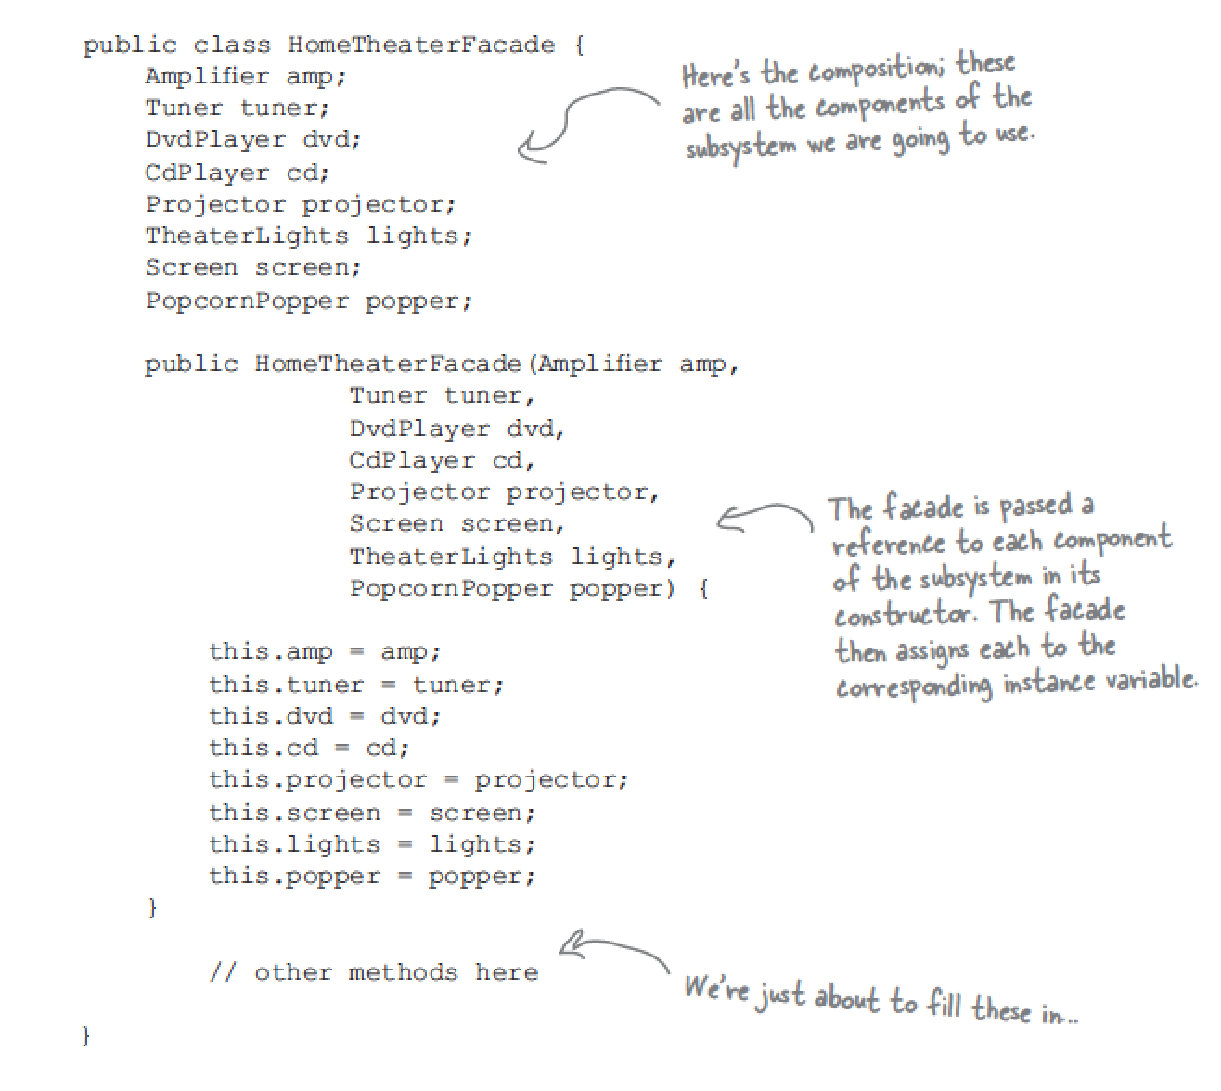
Example of facade pattern
Data source: Head first design pattern

Slide 15
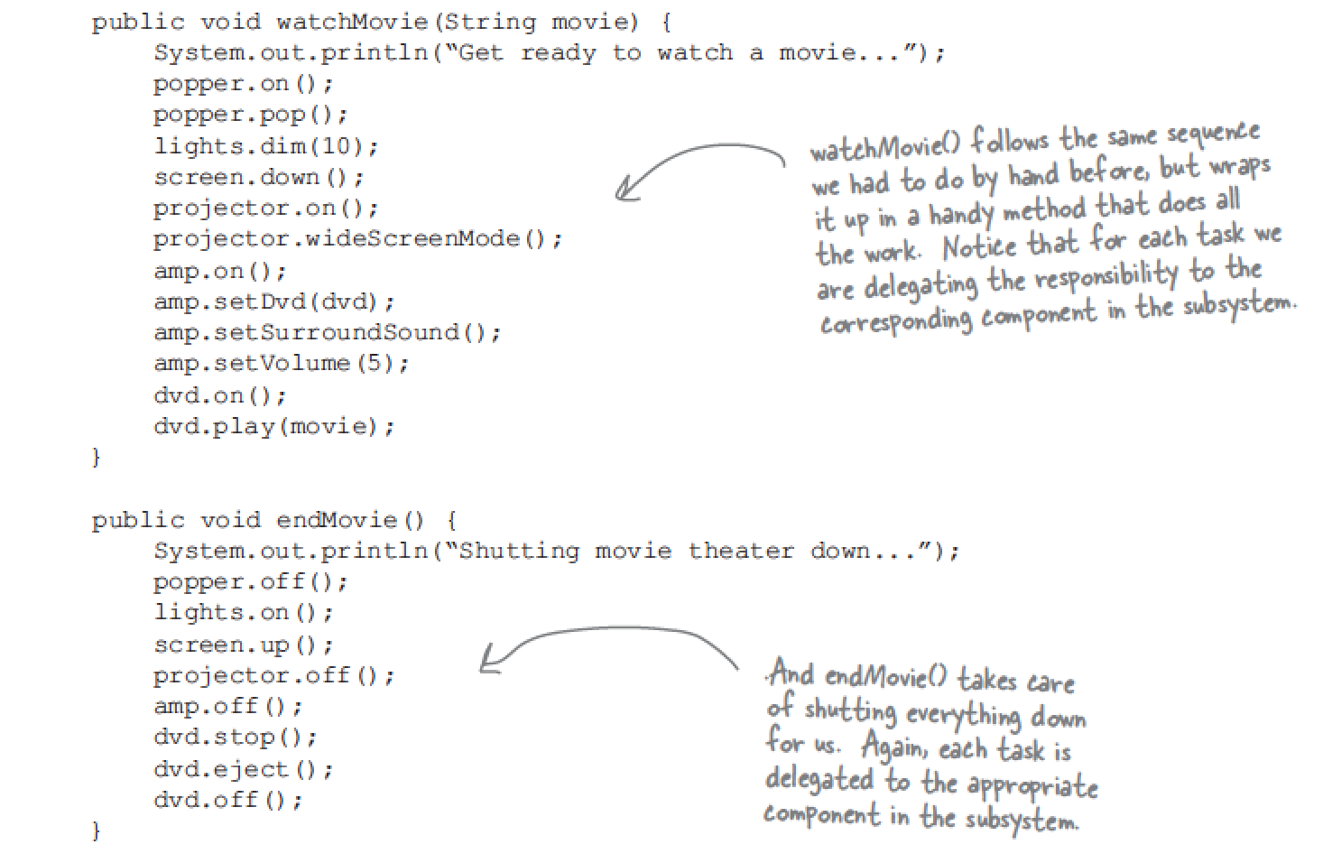
Example of facade pattern (cont.)
Data source: Head first design pattern

Slide 16
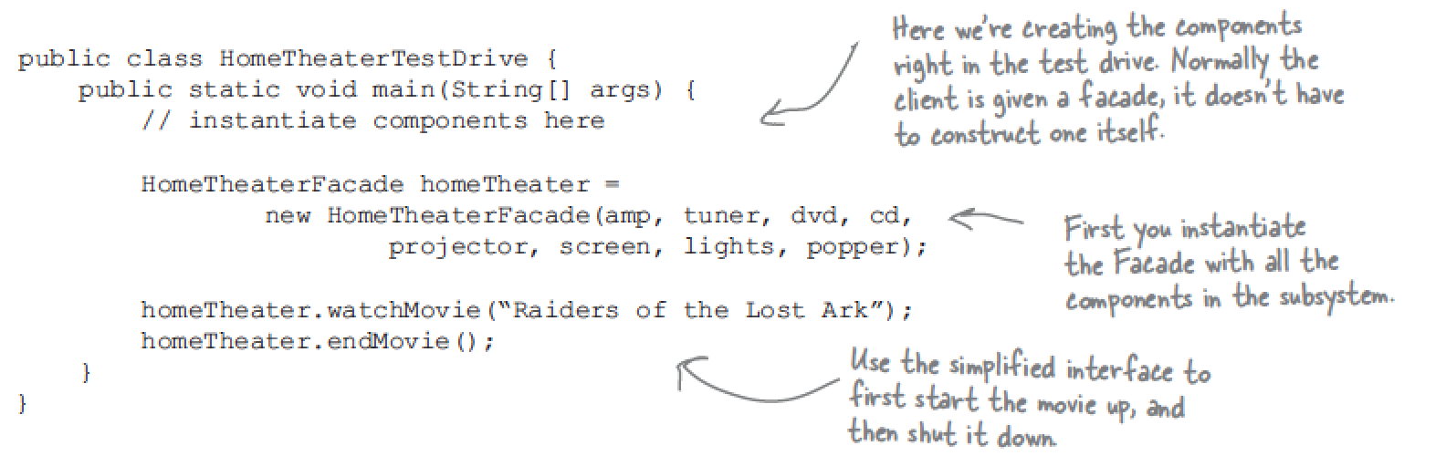
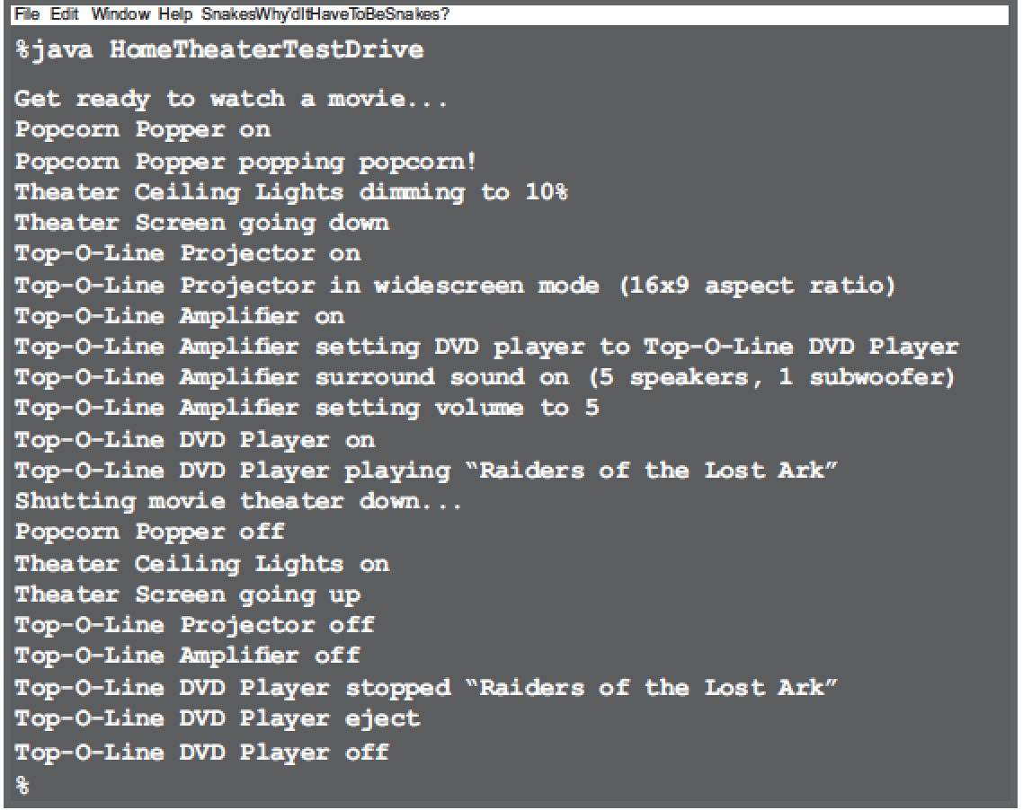
Example of using facade pattern
Data source: Head first design pattern

Slide 17
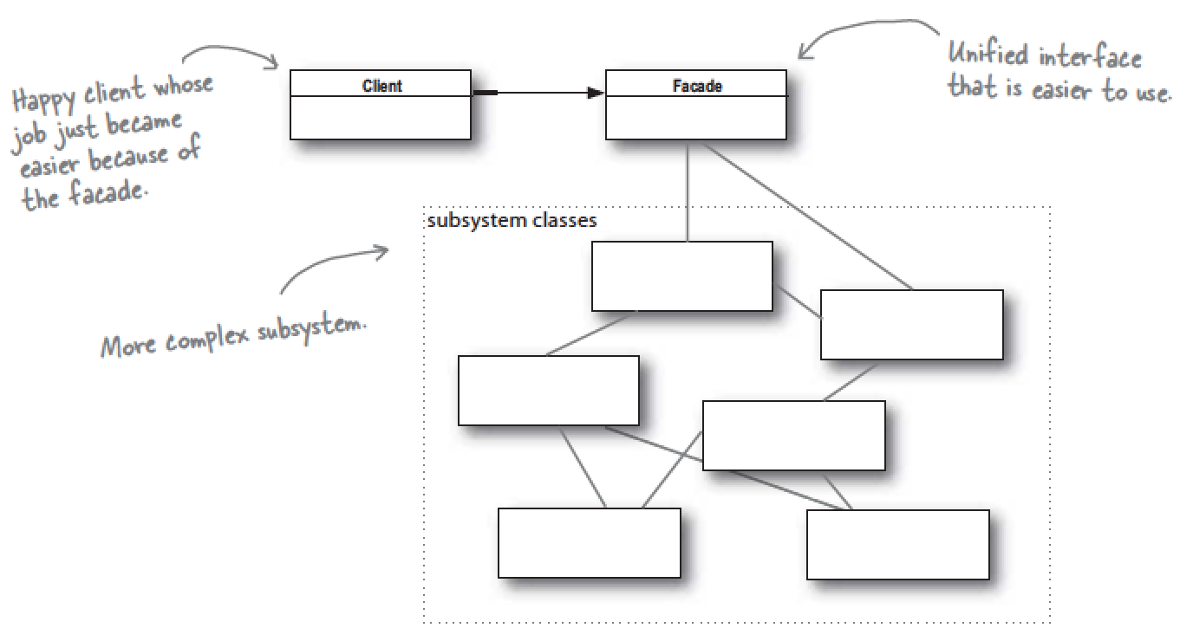
Definition of facade pattern
Facade pattern provide a unified interface to a set of interfaces in a subsystem.
Data source: Head first design pattern

Slide 18
Note
1. Facade don’t “encapsulate” the subsystem classes; they merely provide a simplified interface to their functionality.
2. Facade also allows you decouple your client implementation from any one subsystem.

Slide 19
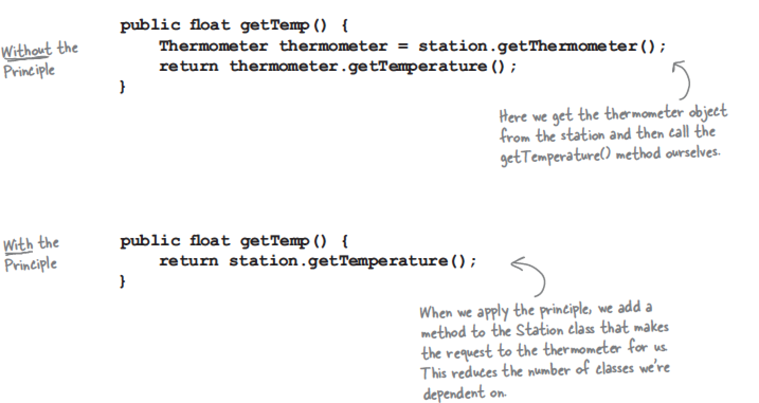
The principle of Least knowledge
Talk only to your immediate friends.
Also called Law of Demeter
Ex:
Data source: Head first design pattern

Slide 20
More

Slide 21
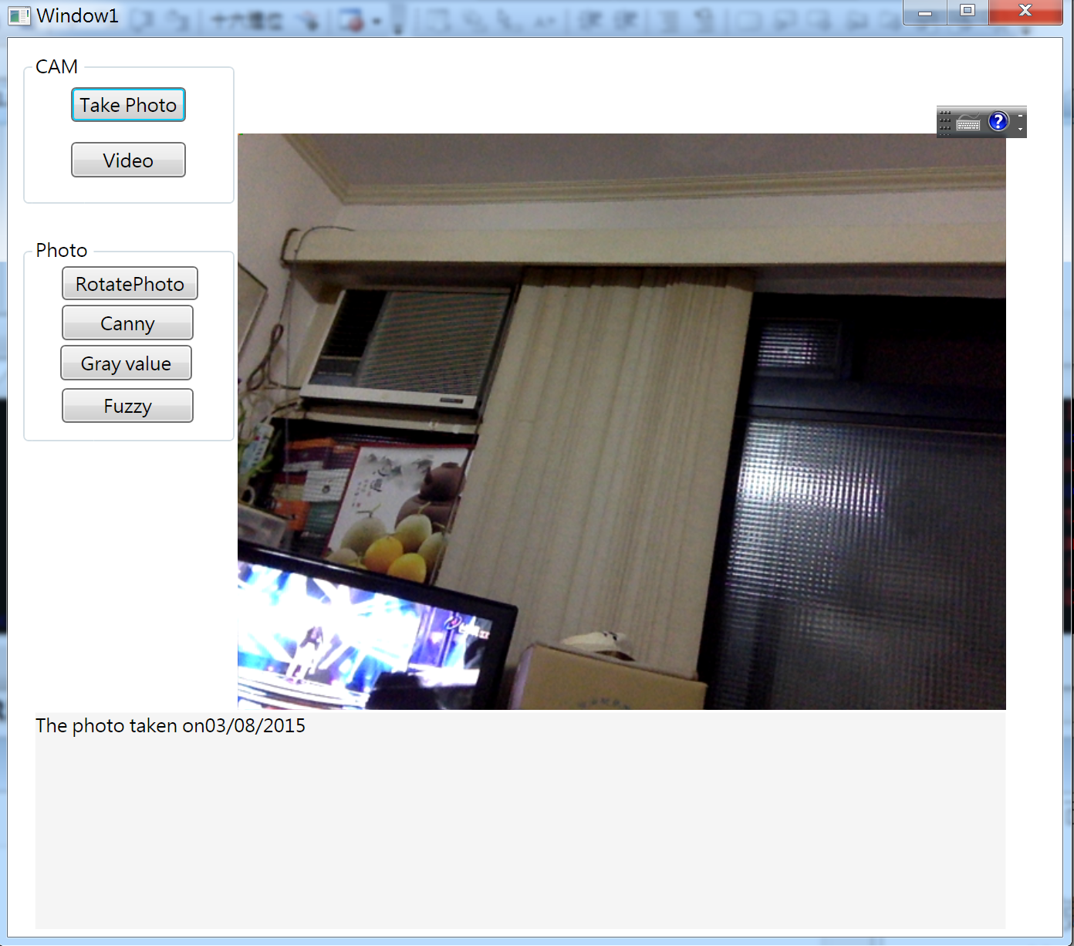
Image editor

Slide 22
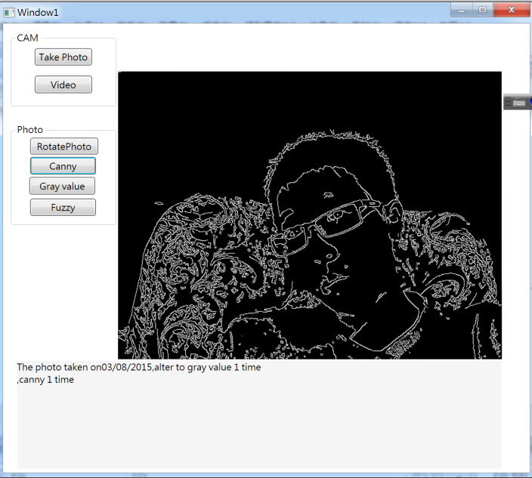
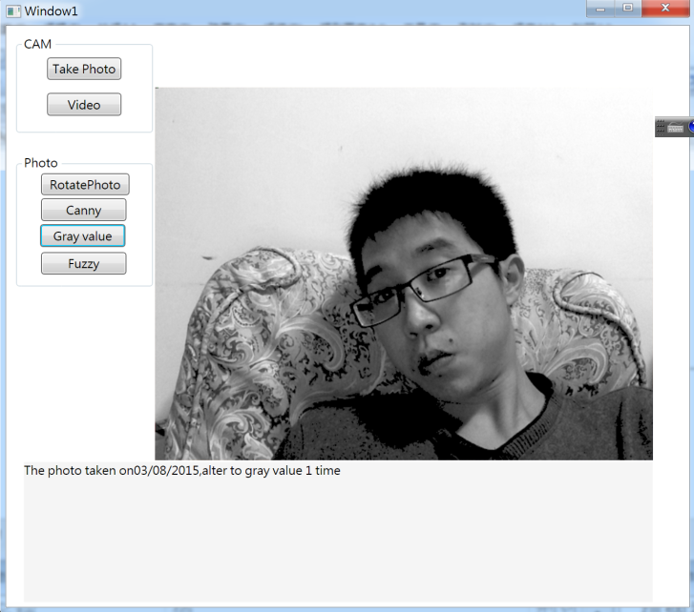
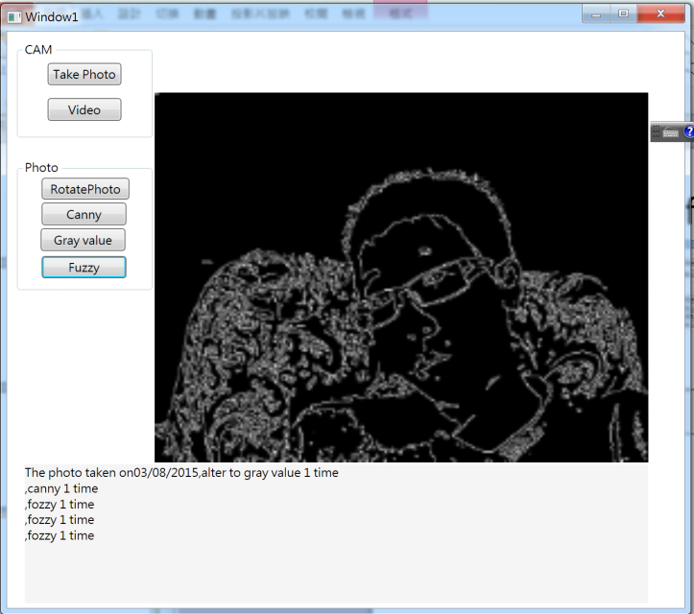
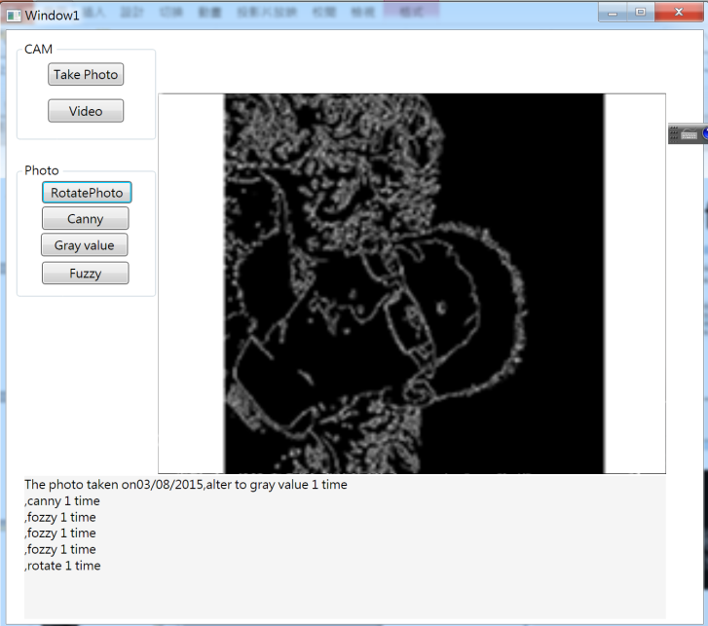
Functions of image editor

Slide 23
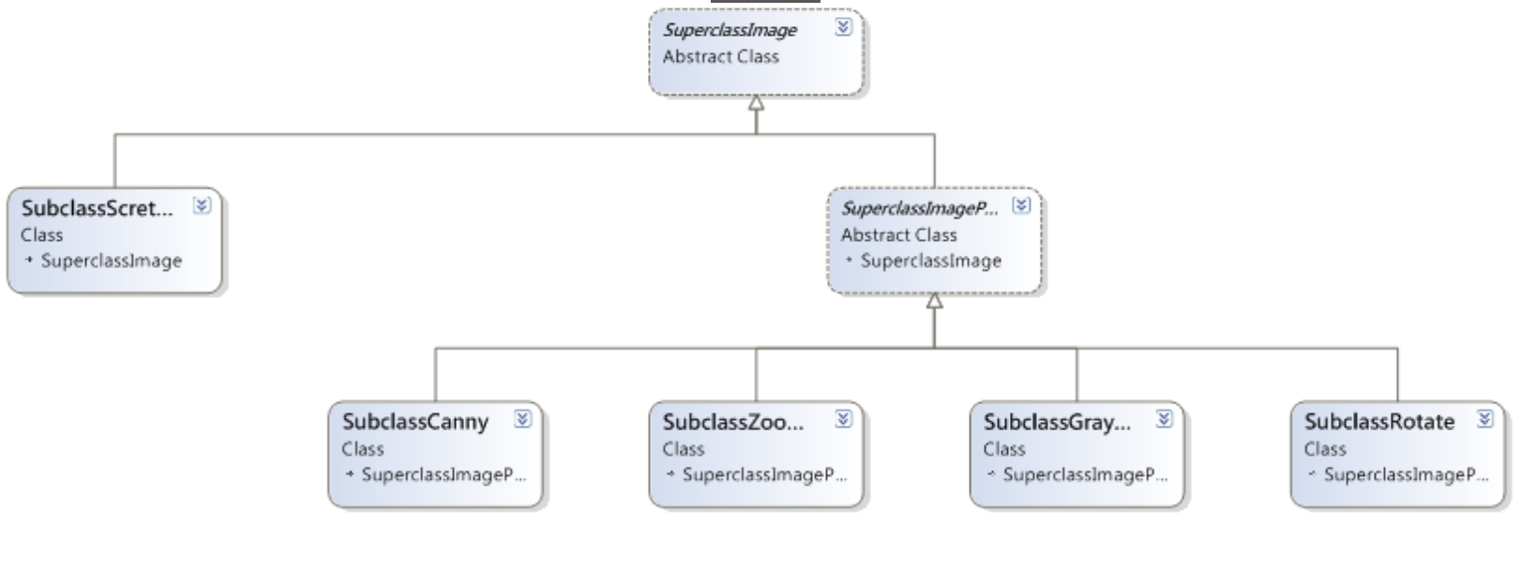
Class diagram of image editor

Slide 24
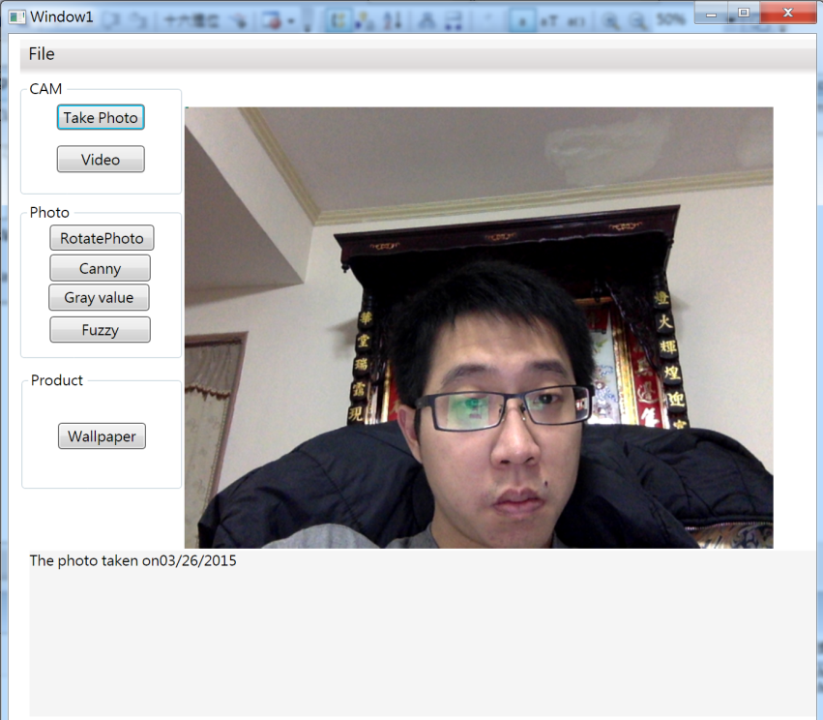
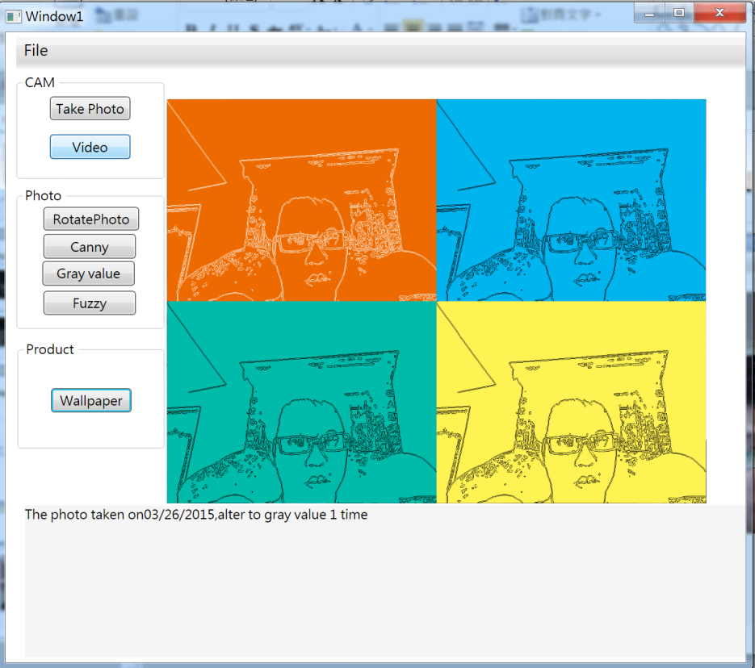
Wallpaper Product

Slide 25
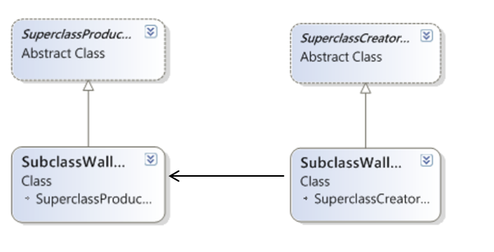
Class diagram of Wallpaper Product

Slide 26
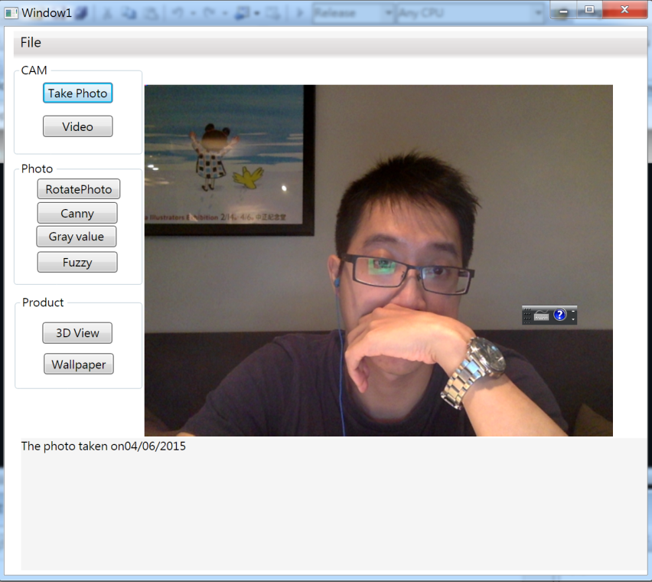
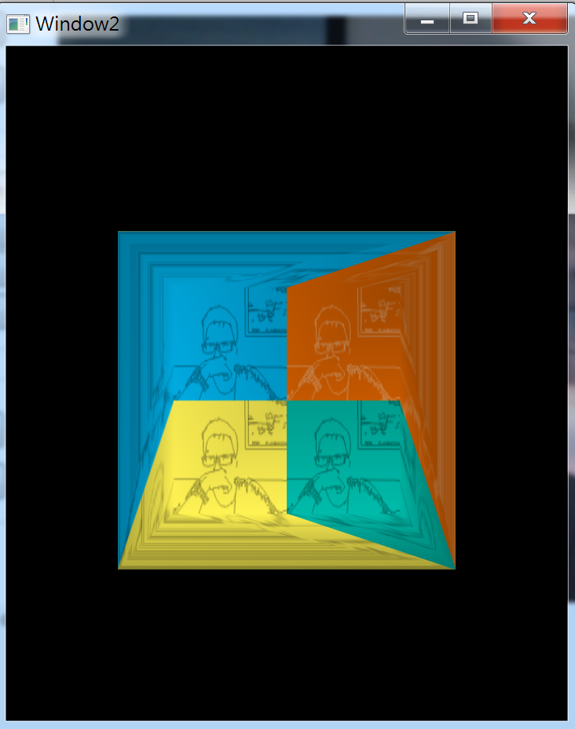
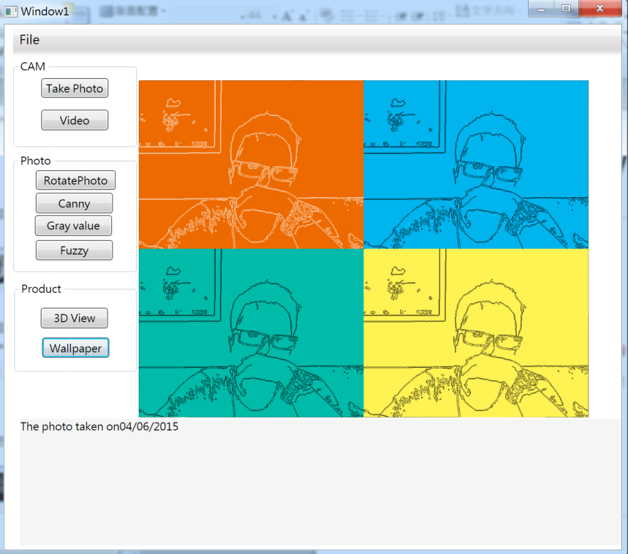
3D View

Slide 27
Class diagram of Wallpaper Product

